Slide 1
CPSC 542
Group Project Presentation

Slide 2
Agenda
Team Member Introduction
Project Introduction
Test Plan
Test Demo
Project Introduction
Test Result

Slide 3
Team Member Introduction

Slide 4
Team Member Introduction
Shih-Li Hsu (hsushihli@gmail.com)
Jennifer Wu (chihyi1126@csu.fullerton.edu)
Gan Liu (lgvincent@csu.fullerton.edu)

Slide 5
Project Introduction

Slide 6
Project Introduction
This project: SWAGLABS.
The purpose: To test the function of the SWAGLABS website is satisfied for the client side or not.
Working Process: Using Selenium to test the operation of SWAGLABS.
Testing Methodology: Automation Testing

Slide 7
Automation Testing
Automation Testing is the use of software separate from the software being tested to control the execution of tests and the comparison of actual outcomes with predicted outcomes.
Test automation can automate some repetitive but necessary tasks in a formalized testing process already in place, or perform additional testing that would be difficult to do manually. Test automation is critical for continuous delivery and continuous testing

Slide 8
Test Plan

Slide 9
Test Plan
1. Test plan identifier
CPSC 542 Group Project Test Plan
2. Introduction
This test plan is for testing if all functions in SWAGLABS project will be works correctly.
3. Items to be tested
The URL being tested:https://www.saucedemo.com/
Unit 1 Testing: Login.
Unit 2 Testing: Add items.
Unit 3 Testing: Shopping Cart.
4. Features to be tested
To display the result message in Selenium.

Slide 10
Test Plan
5. Approach
Automatic test.
6. Pass/Fail criteria
Pass criteria: The test result is consistent with the expected result.
Fail criteria: Compile fail.
The test result is inconsistent with the expected result.
7. Suspension and resumption criteria
Suspension criteria: The end of a workday,or critical defects found.
Resumption criteria: The next morning of a workday.
8. Test deliverables
Automatic test cases.

Slide 11
Test Plan
9. Test environment
PC with windows 10 or Ubuntu 20.0x; Mac with MacOS 10.15.7
Github. Google chrome.
10. Staffing and training needs
Educational background or training of software testing.
11. Scheduling
10/25/2021, open source code received, all tests are designed.
11/01/2021, establish the testing plan.
11/15/2021, all tests are completed and recorded.

Slide 12
Test Plan
13. Risks and Contingencies
Open source code is not completed as expected
Tight delivery deadline
14. Testing Costs
Costs of planning and designing the tests: $360.00
Costs of acquiring the hardware and software necessary for the tests: $530.00
Costs to support the test environment: $0.00
Costs of executing the tests: $500.00
Costs of recording and analyzing test results: $400.00
Total: $1790.00
15. Approval Status
Approve.

Slide 13
Test Tool

Slide 14

Test Tool
Selenium is a free (open-source) automated testing framework used to validate web applications across different browsers and platforms.
Multiple programming languages like Java, C#, Python etc to create Selenium Test Scripts. Testing done using the Selenium testing tool is usually referred to as Selenium Testing.
Not just a single tool but a suite of software, each piece catering to different Selenium QA testing needs of an organization. Here is the list of tools
Selenium Integrated Development Environment (IDE)
Selenium Remote Control (RC)
WebDriver
Selenium Grid
Notes:
Summary and concept

Slide 15
Advantages and Disadvantages of Selenium
Advantages:
1) Selenium is an Open Source Software.
2) Selenium supports various programming languages to write programs (Test scripts)
3) Selenium supports various operating systems (MS Windows, Linux, Macintosh etc...)
4) Selenium supports various Browsers (Mozilla Firefox, Google Chrome, IE, Opera, Safari etc...)
5) Selenium supports Parallel Test Execution.
6) Selenium uses fewer Hardware resources.
Disadvantages:
1) No reliable Technical Support from anybody.
2) It supports Web-based applications only.
3) Difficult to use, takes more time to create Test cases.
4) Difficult to Setup Test Environment when it compares to Vendor Tools like UFT, RFT, SilkTest etc...

Slide 16
Project Introduction

Slide 17
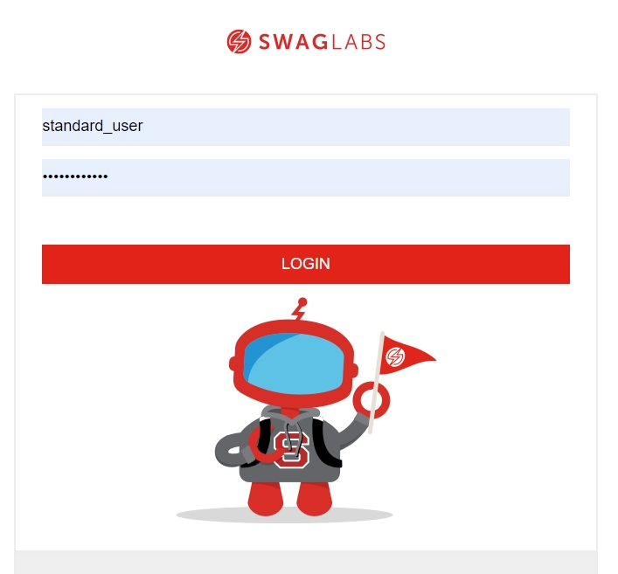
SWAG LABS
Introduction

Slide 18
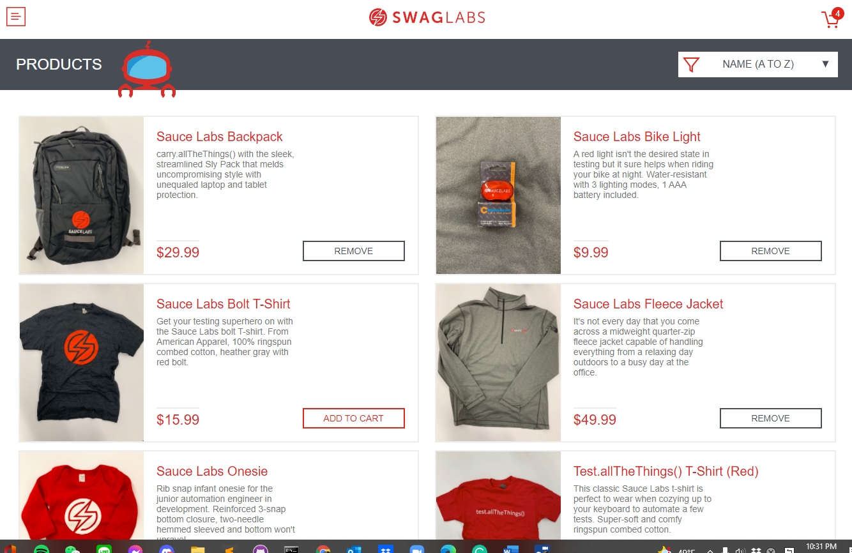
Product Page

Slide 19
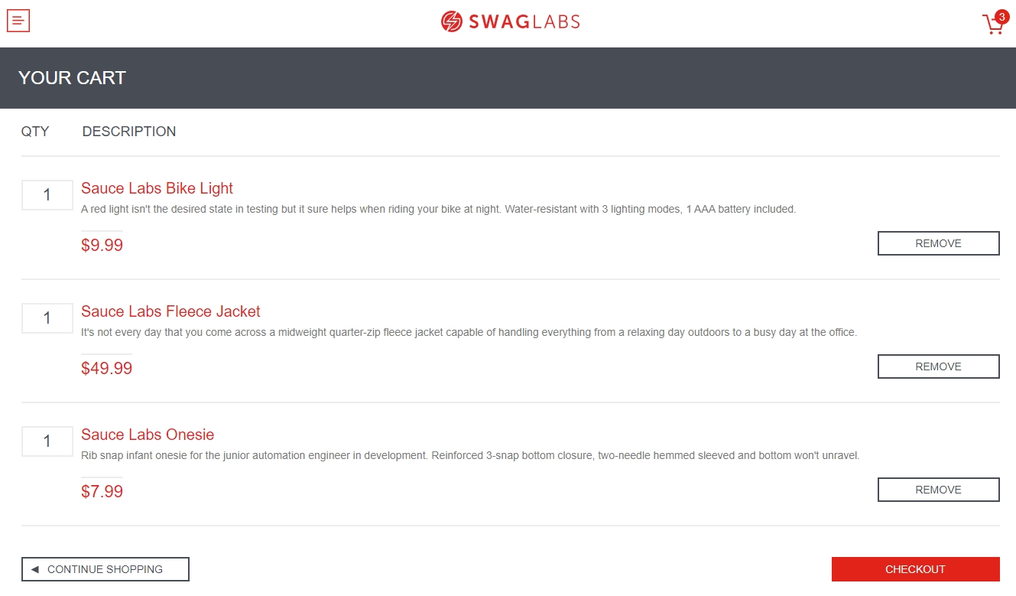
Cart Page

Slide 20
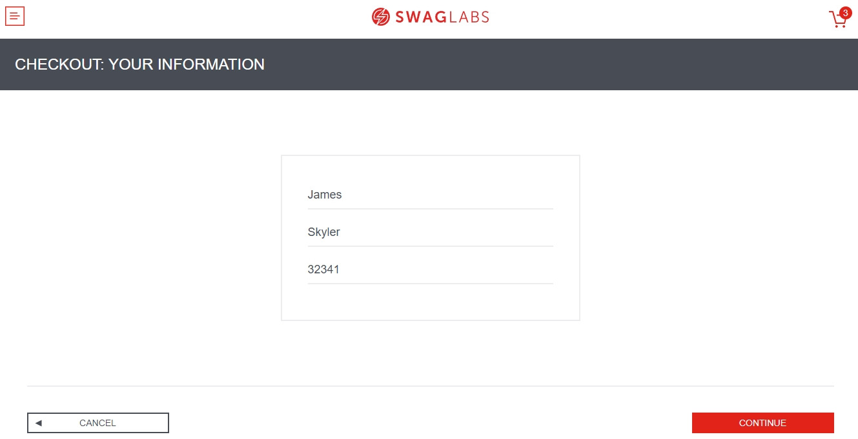
Check out Information

Slide 21
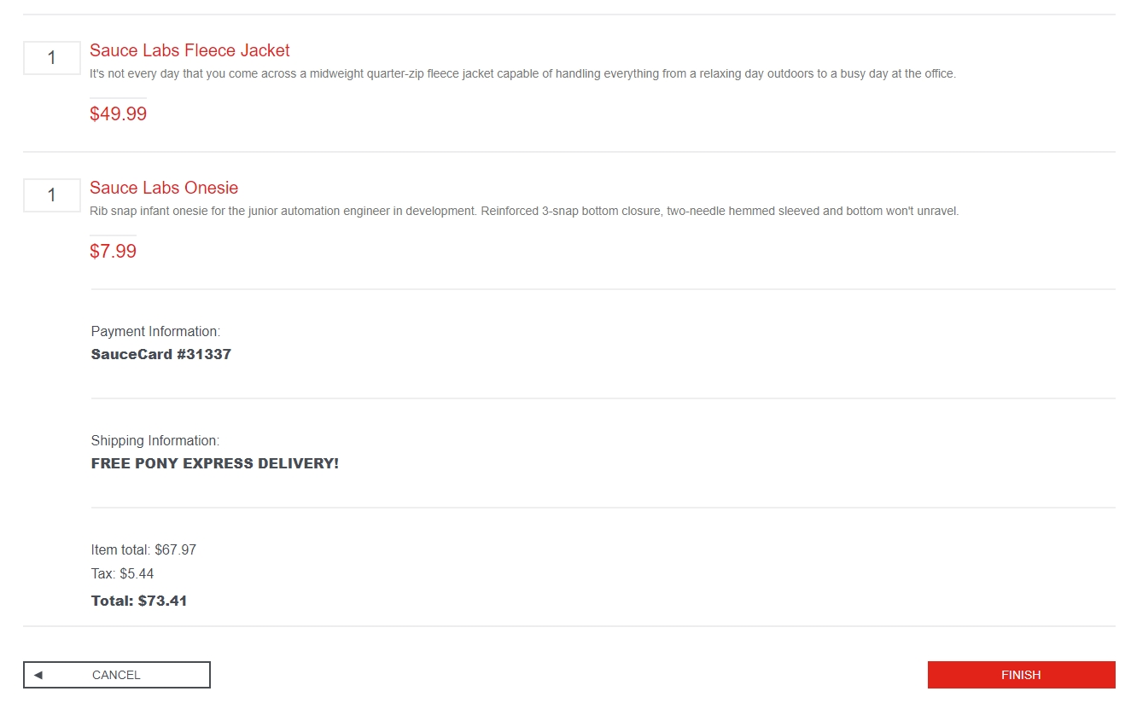
Total Item Information

Slide 22
Test Demo

Slide 23
SWAG LABS TEST DEMO

Slide 24
Test Result

Slide 25
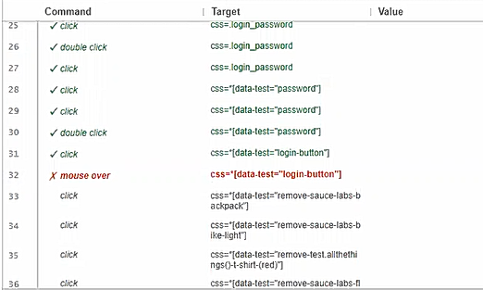
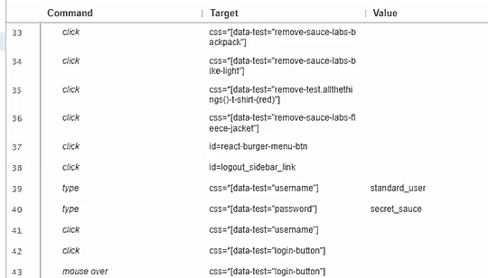
Test result

Slide 26
Thank you!

